Slide 1
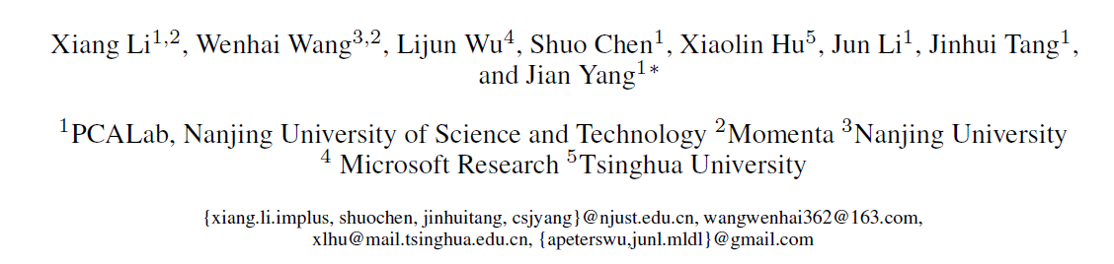
Generalized Focal Loss:
Learning Qualified and Distributed Bounding Boxes
for Dense Object Detection
Advances in neural information processing systems (Nips), 2020
Student: MS2023 馮彥達 V1
Advisor: Jenn-Jier James Lien
Robotics Lab, CSIE NCKU
Edited date: 2025/03/18

Slide 2
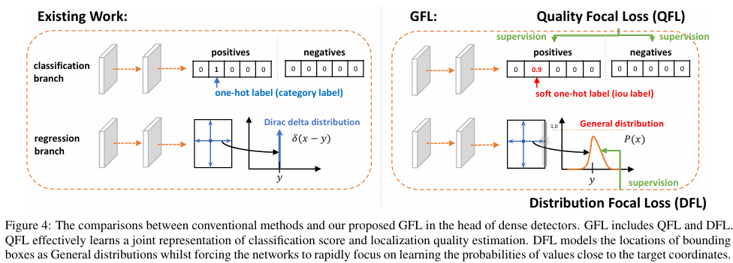
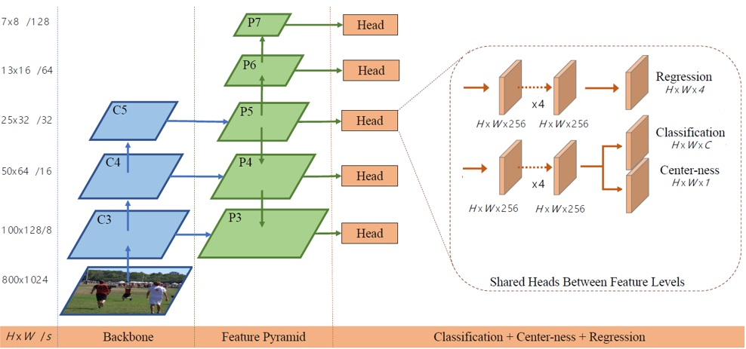
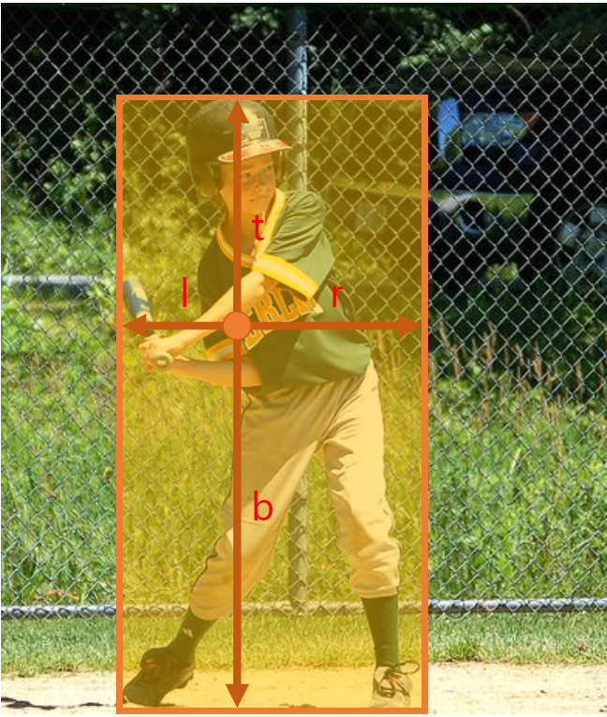
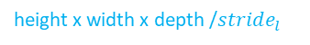
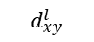
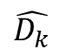
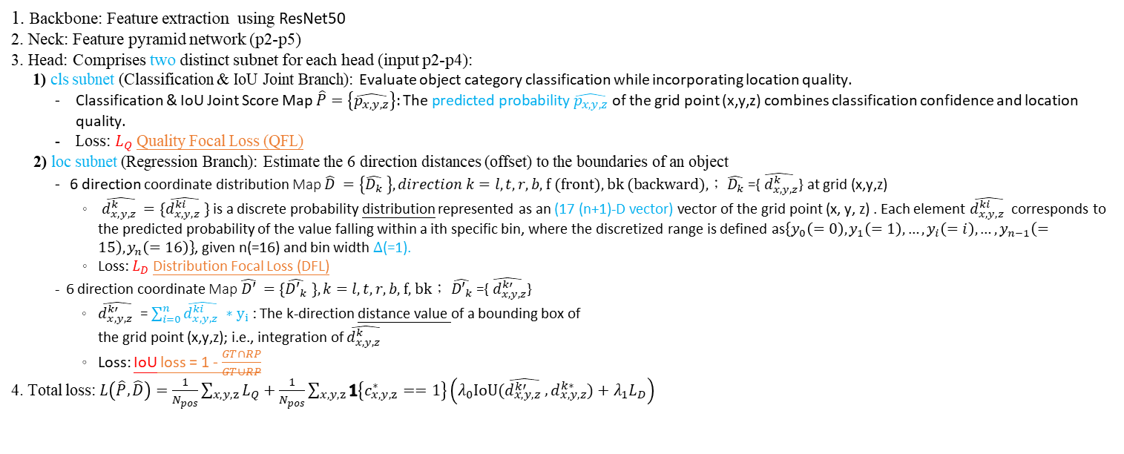
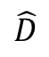
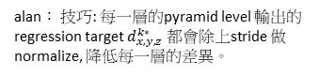
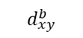
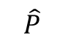
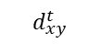
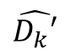
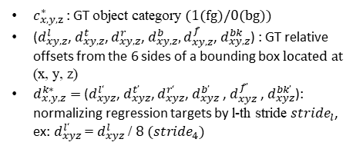
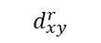
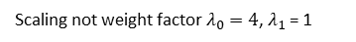
1.1 Introduction: Motivation, Objective and Global Framework ?? PAN net
Global Framework- Modified FCOS with Generalized Focal Loss (our)
Backbone:
Feature Extraction using ResNet50
2. Neck:
Feature Pyramid Network
3. Head (Ex. input p4)
6x6x6 /16
C5
P5
1) cls subnet
x4
$$\hat{P}$$
12x12x12 /8
C4
P4
12x12x12x256c
Conv 1x1x1 ➔12x12x12x1c
$$\hat{D}$$
X6 direction
24x24x24 /4
C3
P3
x4
$$\hat{D_{k}}$$
$$\hat{D_{k}′}$$
C2
P2
2) loc subnet
integral
48x48x48 /2
Conv 1x1x1
➔12x12x12x102c
(6 directions x 17 bins =102)
12x12x12x256c
96x96x96 /1
17個bin (0-16)/direction
height x width x depth /$stride_{l}$
Classification & IoU Branch + Regression Branch
1. Backbone: Feature extraction using ResNet50
2. Neck: Feature pyramid network (p2-p5)
3. Head: Comprises two distinct subnet for each head (input p2-p4):
1) cls subnet (Classification & IoU Joint Branch): Evaluate object category classification while incorporating location quality.
Classification & IoU Joint Score Map $\hat{P}=\left\{\hat{p_{x,y,z}}\right\}:\text{The} \text{predicted} \text{probability} \hat{p_{x,y,z}}$ of the grid point (x,y,z) combines classification confidence and location quality.
Loss: $L_{Q}$Quality Focal Loss (QFL)
2) loc subnet (Regression Branch): Estimate the 6 direction distances (offset) to the boundaries of an object
6 direction coordinate distribution Map $\hat{D} =\left\{\hat{D_{k}} \right\},direction k=l,t,r,b\text{, }\text{f}\text{ (}\text{front}\text{), }\text{bk}\text{ (}\text{backward}\text{),}\text{；} \hat{D_{k}} \text{=\{}\hat{{ d}_{x,y,z}^{k}}\text{\}}$ at grid (x,y,z)
$\hat{d_{x,y,z}^{k} }$ $=\{\hat{d_{x,y,z}^{ki} }\}$ is a discrete probability distribution represented as an (17 (n+1)-D vector) vector of the grid point (x, y, z) . Each element $\hat{d_{x,y,z}^{ki} }$ corresponds to the predicted probability of the value falling within a ith specific bin, where the discretized range is defined as$\left\{y_{0}\left(=0\right), y_{1}\left(=1\right), …,y_{i}\left(=i\right), …,y_{n−1}\left(=15\right),y_{n}\left(=16\right)\right\}$, given n(=16) and bin width $Δ$(=1).
Loss: $L_{D}$Distribution Focal Loss (DFL)
6 direction coordinate Map $\hat{D′} =\{\hat{{D′}_{k}} \},k=l,t,r,b\text{, }\text{f}\text{, }\text{bk}\text{；} \hat{{D′}_{k}} \text{=\{}\hat{{ d}_{x,y,z}^{k′}}\text{\}}$
$\hat{d_{x,y,z}^{k′} }$ = $\sum_{i=0}^{n}{\hat{d_{x,y,z}^{ki} }}∗y_{i}$: The k-direction distance value of a bounding box of
the grid point (x,y,z); i.e., integration of $\hat{d_{x,y,z}^{k} }$
Loss: IoU loss = 1 - $\frac{GT∩RP}{GT∪RP}$
4. Total loss: $L\left(\hat{P},\hat{D}\right)=\frac{1}{N_{pos}}\sum_{x,y,z}{L_{Q}}+\frac{1}{N_{pos}}\sum_{x,y,z}{1\left\{c_{x,y,z}^{∗}==1\right\}\left(λ_{0}IoU(\hat{d_{x,y,z}^{k′} },d_{x,y,z}^{k∗})+λ_{1}L_{D}\right)}$
Alan:
Pyramid Level (l) 越大，解析度越小，適合預測大物件
Pyramid Level (l) 越小，解析度越高，適合預測小物件
分析：Nodule 多為小物件，因此選用 P2-P4。
?
Alan: 以P4 當作輸入為例
(x, y) = (0~11, 0~11)
?
$c_{x,y,z}^{∗}$: GT object category (1(fg)/0(bg))
($d_{xy,z}^{l}$, $d_{xy,z}^{t}$, $d_{xy,z}^{r}$, $d_{xy,z}^{b},d_{xy,z}^{f}$, $d_{xy,z}^{bk}$) : GT relative offsets from the 6 sides of a bounding box located at (x, y, z)
$d_{x,y,z}^{k∗}=$($d_{xyz}^{l‘}$, $d_{xyz}^{t’}$, $d_{xyz}^{r‘}$, $d_{xyz}^{b’}$ , $d_{xyz}^{f’}$ , $d_{xyz}^{bk’}$): normalizing regression targets by l-th stride $stride_{l}$, ex: $d_{xyz}^{l‘}$ = $d_{xyz}^{l}$ / $8 (stride_{4})$
$$d_{xy}^{t}$$
integral
(x,y)
Alan: 求distribution 的期望值,將分布轉換成一個數值
$$d_{xy}^{l}$$
$$d_{xy}^{r}$$
alan： 技巧: 每一層的pyramid level 輸出的regression target $d_{x,y,z}^{k∗}$ 都會除上stride 做 normalize, 降低每一層的差異。
$$d_{xy}^{b}$$
Scaling not weight factor $λ_{0}=4$, $λ_{1}$ = 1

Slide 3
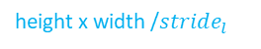
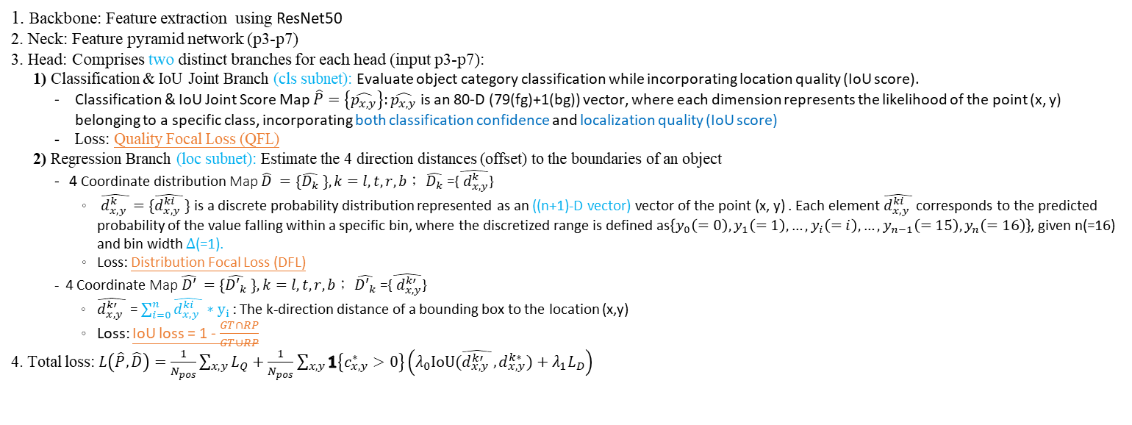
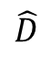
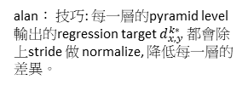
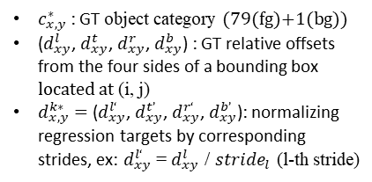
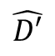
1.1 Introduction: Motivation, Objective and Global Framework
Global Framework- Modified FCOS with Generalized Focal Loss (paper)
3. Head (Ex. input p5)
Backbone:
Feature Extraction using ResNet50
2. Neck:
Feature Pyramid Network
1) cls subnet
x4
$$\hat{P}$$
HxWx80c (80 classes)
HxWx256
HxWx256
x4
$$\hat{D}$$
$$\hat{D′}$$
x4
2) loc subnet
HxWx64c
(4 directions x 16 bins 16)
integral
HxWx256
HxWx256
height x width /$stride_{l}$
Classification & IoU Branch + Regression Branch
1. Backbone: Feature extraction using ResNet50
2. Neck: Feature pyramid network (p3-p7)
3. Head: Comprises two distinct branches for each head (input p3-p7):
1) Classification & IoU Joint Branch (cls subnet): Evaluate object category classification while incorporating location quality (IoU score).
Classification & IoU Joint Score Map $\hat{P}=\left\{\hat{p_{x,y}}\right\}:\hat{p_{x,y}}$ is an 80-D (79(fg)+1(bg)) vector, where each dimension represents the likelihood of the point (x, y) belonging to a specific class, incorporating both classification confidence and localization quality (IoU score)
Loss: Quality Focal Loss (QFL)
2) Regression Branch (loc subnet): Estimate the 4 direction distances (offset) to the boundaries of an object
4 Coordinate distribution Map $\hat{D} =\{\hat{D_{k}} \},k=l,t,r,b\text{；} \hat{D_{k}} \text{=\{}\hat{{ d}_{x,y}^{k}}\text{\}}$
$\hat{d_{x,y}^{k} }$ $=\{\hat{d_{x,y}^{ki} }\}$ is a discrete probability distribution represented as an ((n+1)-D vector) vector of the point (x, y) . Each element $\hat{d_{x,y}^{ki} }$ corresponds to the predicted probability of the value falling within a specific bin, where the discretized range is defined as$\left\{y_{0}\left(=0\right), y_{1}\left(=1\right), …,y_{i}\left(=i\right), …,y_{n−1}\left(=15\right),y_{n}\left(=16\right)\right\}$, given n(=16) and bin width $Δ$(=1).
Loss: Distribution Focal Loss (DFL)
4 Coordinate Map $\hat{D′} =\{\hat{{D′}_{k}} \},k=l,t,r,b\text{；} \hat{{D′}_{k}} \text{=\{}\hat{{ d}_{x,y}^{k′}}\text{\}}$
$\hat{d_{x,y}^{k′} }$ = $\sum_{i=0}^{n}{\hat{d_{x,y}^{ki} }}∗y_{i}$: The k-direction distance of a bounding box to the location (x,y)
Loss: IoU loss = 1 - $\frac{GT∩RP}{GT∪RP}$
4. Total loss: $L\left(\hat{P},\hat{D}\right)=\frac{1}{N_{pos}}\sum_{x,y}{L_{Q}}+\frac{1}{N_{pos}}\sum_{x,y}{1\left\{c_{x,y}^{∗}>0\right\}\left(λ_{0}IoU(\hat{d_{x,y}^{k′} },d_{x,y}^{k∗})+λ_{1}L_{D}\right)}$
?
Alan: 以P5 當作輸入為例
(x, y) = (0~24, 0~31)
?
Alan: 求distribution 的期望值,將分布轉換成一個數值
$c_{x,y}^{∗}$: GT object category (79(fg)+1(bg))
($d_{xy}^{l}$, $d_{xy}^{t}$, $d_{xy}^{r}$, $d_{xy}^{b}$) : GT relative offsets from the four sides of a bounding box located at (i, j)
$d_{x,y}^{k∗}=$($d_{xy}^{l‘}$, $d_{xy}^{t’}$, $d_{xy}^{r‘}$, $d_{xy}^{b’}$): normalizing regression targets by corresponding strides, ex: $d_{xy}^{l‘}$ = $d_{xy}^{l}$ / $stride_{l}$ (l-th stride)
$$d_{xy}^{t}$$
integral
(x,y)
$$d_{xy}^{l}$$
$$d_{xy}^{r}$$
alan： 技巧: 每一層的pyramid level 輸出的regression target $d_{x,y}^{k∗}$ 都會除上stride 做 normalize, 降低每一層的差異。
$$d_{xy}^{b}$$

Slide 4
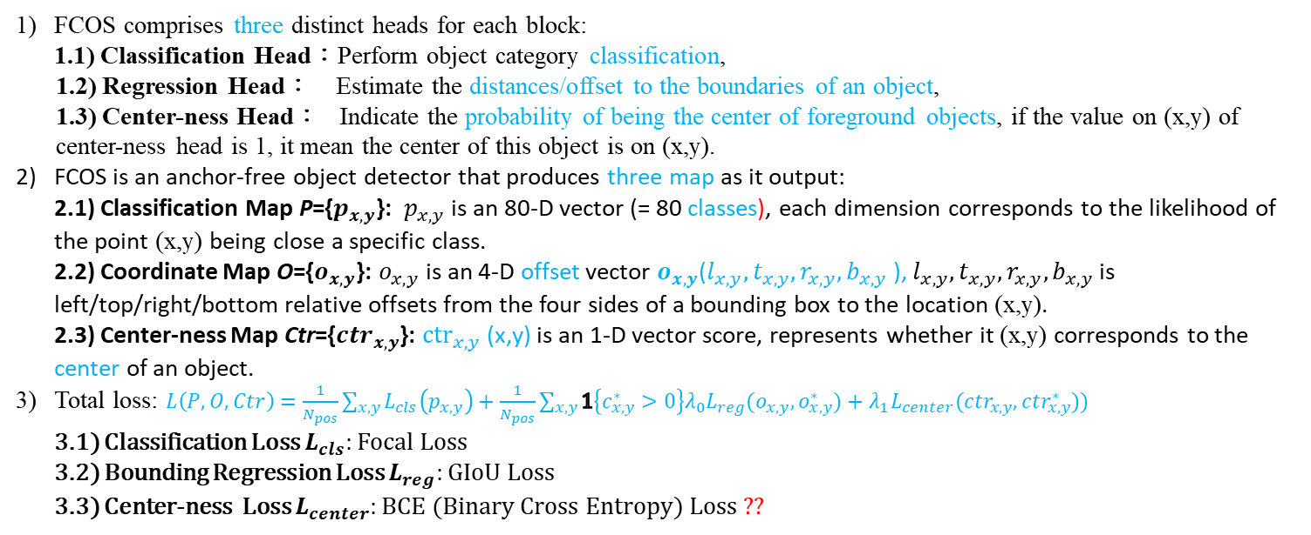
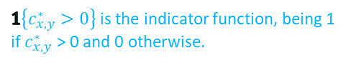
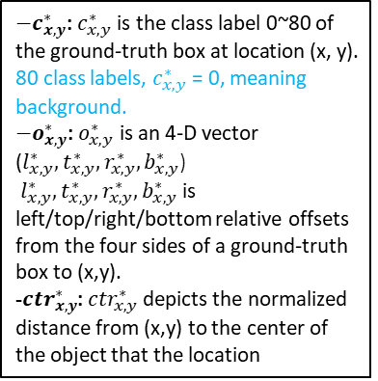
1.2 Related Works - FCOS
- Loss function of this paper can apply to Anchor or anchor free case
FCOS (Fully Convolutional One-Stage Object Detector)
FCOS comprises three distinct heads for each block:
1.1) Classification Head：Perform object category classification,
1.2) Regression Head： Estimate the distances/offset to the boundaries of an object,
1.3) Center-ness Head： Indicate the probability of being the center of foreground objects, if the value on (x,y) of center-ness head is 1, it mean the center of this object is on (x,y).
FCOS is an anchor-free object detector that produces three map as it output:
2.1) Classification Map P={$p_{x,y}$}: $p_{x,y​}$is an 80-D vector (= 80 classes), each dimension corresponds to the likelihood of the point (x,y) being close a specific class.
2.2) Coordinate Map O={$o_{x,y}$}: $o_{x,y}$ is an 4-D offset vector $o_{x,y}$($l_{x,y},t_{x,y},r_{x,y},b_{x,y}$), $l_{x,y},t_{x,y},r_{x,y},b_{x,y}$is left/top/right/bottom relative offsets from the four sides of a bounding box to the location (x,y).
2.3) Center-ness Map Ctr={${ctr}_{x,y}$}: ${ctr}_{x,y}$ (x,y) is an 1-D vector score, represents whether it (x,y) corresponds to the center of an object.
Total loss: $L\left(P, O,Ctr\right)=\frac{1}{N_{pos}}\sum_{x,y}{L_{cls}\left(p_{x,y}\right)}+\frac{1}{N_{pos}}\sum_{x,y}{1\left\{c_{x,y}^{∗}>0\right\}{λ_{0}L}_{reg}(o_{x,y},o_{x,y}^{∗})}$ $+$ ${λ_{1}L}_{center}({ctr}_{x,y},{ctr}_{x,y}^{∗}))$
3.1) Classification Loss $L_{cls}$: Focal Loss
3.2) Bounding Regression Loss $L_{reg}$: GIoU Loss
3.3) Center-ness Loss $L_{center}$: BCE (Binary Cross Entropy) Loss ??
$1\left\{c_{x,y}^{∗}>0\right\}$ is the indicator function, being 1 if $c_{x,y}^{∗}$ > 0 and 0 otherwise.
$−c_{x,y}^{∗}$: $c_{x,y}^{∗}$is the class label 0~80 of the ground-truth box at location (x, y).
80 class labels, $c_{x,y}^{∗}$= 0, meaning background.
$−o_{x,y}^{∗}$: $o_{x,y}^{∗}$ is an 4-D vector ($l_{x,y}^{∗},t_{x,y}^{∗},r_{x,y}^{∗},b_{x,y}^{∗}$)
$l_{x,y}^{∗},t_{x,y}^{∗},r_{x,y}^{∗},b_{x,y}^{∗}$is left/top/right/bottom relative offsets from the four sides of a ground-truth box to (x,y).
-${ctr}_{x,y}^{∗}$: ${ctr}_{x,y}^{∗}$depicts the normalized distance from (x,y) to the center of the object that the location
Original head of FCOS
(x,y)
block
Encoder
Decoder
Head
Alan: like FPN

Slide 5
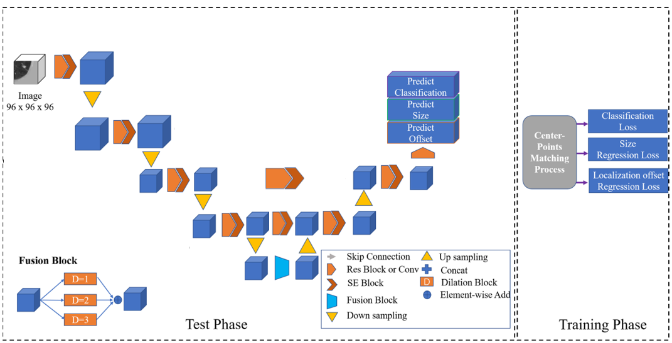

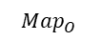
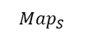
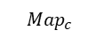
1.2 Related Works - CPM-net
CPM-net
Encoder
Decoder
Input
x1
$$Map_{c}$$
(96x96x96)x32c
(48x48x48)x1c
x2
$$Map_{S}$$
(24x24x24)x3c
$$Map_{O}$$
Re-focal loss
(Left feature map)96c+
(Up-sample feature map)96c
(48x48x48)x96c
(24x24x24)x3c
(48x48x48)x64c
(48x48x48)x64c
x1
x2
x3
L1 Loss
(24x24x24)x96c
(24x24x24)x96c
(Left feature map)128c+
(Up-sample feature map)128c
(24x24x24)x192c
(24x24x24)x96c
L1 Loss
x3
x1
x2
Alan: Fuse deeper multi-scale information
(12x12x12)x128c
(12x12x12)x128c
(12x12x12)x256c
(12x12x12)x128c
(6x6x6)x160c
(6x6x6)x160c
Channel attention
Our version vs. Paper version
(our) Remove Coordinate Map
(our) Only up sample twice
Number of channel are difference
(our) Only have one head output
(our) Size regression loss is L1 loss
Conv 3x3x3, s=1, d=1, p=1
Conv 3x3x3, s=1, d=2, p=2
Conv 3x3x3 + Batch Norm + ReLU
Deconvolutional layers
Conv 3x3x3, s=1, d=3, p=3
Max pooling
d = dilated
Alan: 為了保證輸出的feature map shape 相同

Slide 6
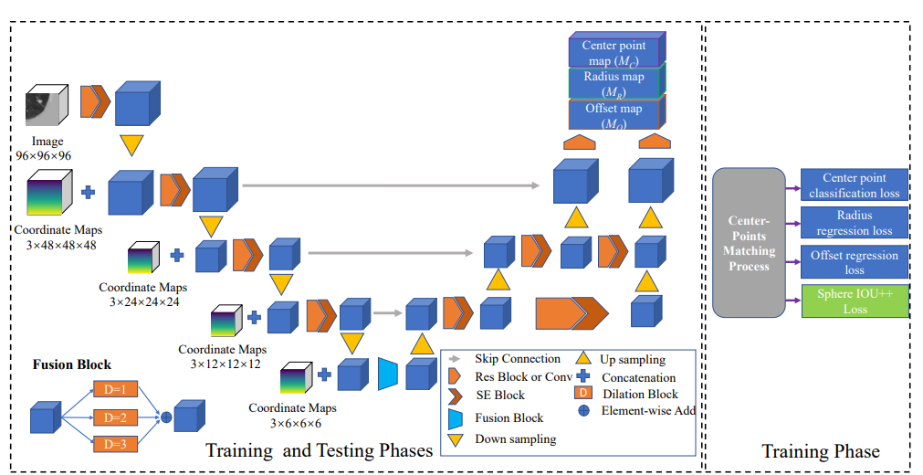
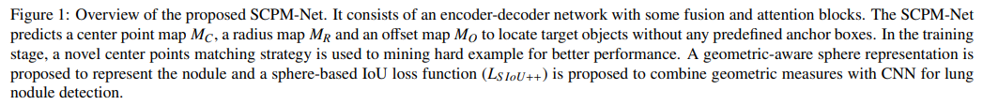
1.2 Related Works - SCPM-net
SCPM-net
Two-level outputs ??
x2
Encoder
Decoder
$$Map_{c}$$
Input
(48x48x48)x1c
$$Map_{R}$$
(48x48x48)x1c
$$Map_{O}$$
(96x96x96)x32c
(48x48x48)x3c
3c+32c
Alan: 擁有高解析度的feature map
Re-focal loss
(48x48x48)x32c
(48x48x48)x64c
(48x48x48)x64c
(48x48x48)x64c
Smooth L1 Loss
(24x24x24)x64c
(24x24x24)x64c
(24x24x24)x64c
L1 Loss
(24x24x24)x64c
(24x24x24)x64c
$$L_{SIoU++}$$
Alan: Fuse deeper multi-scale information
(12x12x12)x64c
(12x12x12)x64c
(12x12x12)x64c
(12x12x12)x64c
(12x12x12)x64c
Total loss
(6x6x6)x64c
(6x6x6)x64c
Channel attention
Conv 3x3x3, s=1, d=1, p=1
Conv 3x3x3, s=1, d=2, p=2
Conv 3x3x3 + Batch Norm + ReLU
Deconvolutional layers
Alan: 為了保證輸出的feature map shape 相同
Conv 3x3x3, s=1, d=3, p=3
Max pooling

Slide 7
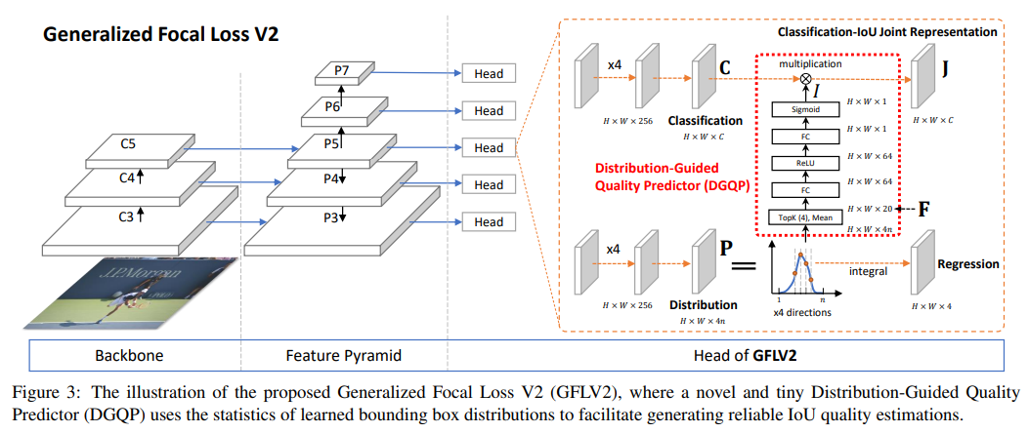
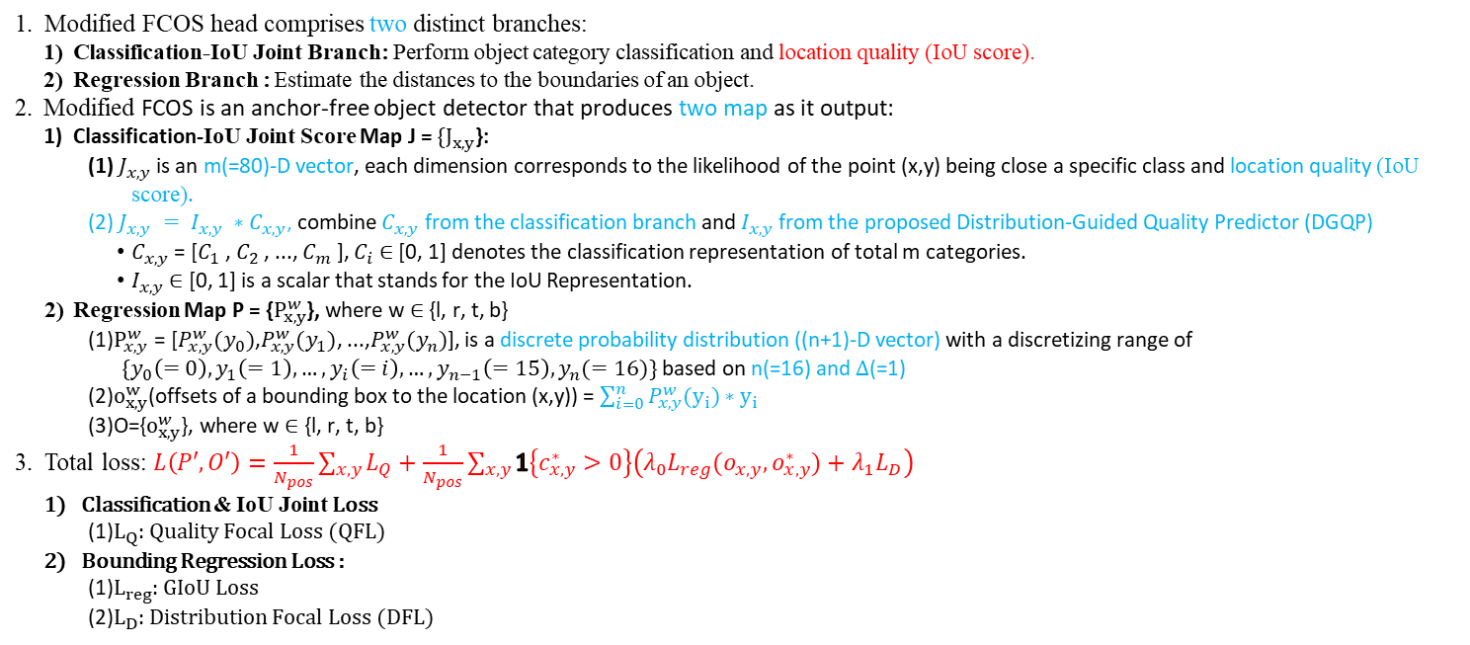
1.2 Related Works – GFocal V2
Global Framework –Generalized Focal Loss V2 ➔ Focal Loss V1 with Distribution-Guided Quality Predictor (DGQP)
Modified FCOS head comprises two distinct branches:
Classification-IoU Joint Branch: Perform object category classification and location quality (IoU score).
Regression Branch : Estimate the distances to the boundaries of an object.
Modified FCOS is an anchor-free object detector that produces two map as it output:
Classification-IoU Joint Score Map J = $\{J_{x,y}$}:
(1) $J_{x,y}$ is an m(=80)-D vector, each dimension corresponds to the likelihood of the point (x,y) being close a specific class and location quality (IoU score).
(2) $J_{x,y} = I_{x,y} ∗C_{x,y}$, combine $C_{x,y}$ from the classification branch and $I_{x,y}$ from the proposed Distribution-Guided Quality Predictor (DGQP)
$C_{x,y}$ = [$C_{1}$ , $C_{2}$ , ..., $C_{m}$ ], $C_{i}$ ∈ [0, 1] denotes the classification representation of total m categories.
$I_{x,y}$ ∈ [0, 1] is a scalar that stands for the IoU Representation.
Regression Map P = {$P_{x,y}^{w}$}, where w ∈ {l, r, t, b}
(1)$P_{x,y}^{w}$ = [$P_{x,y}^{w}(y_{0})$,$P_{x,y}^{w}(y_{1})$, ...,$P_{x,y}^{w}(y_{n})$], is a discrete probability distribution ((n+1)-D vector) with a discretizing range of
$\{y_{0}\left(=0\right), y_{1}\left(=1\right), …,y_{i}\left(=i\right), …,y_{n−1}\left(=15\right),y_{n}(=16)\}$ based on n(=16) and $Δ$(=1)
(2)$o_{x,y}^{w}$(offsets of a bounding box to the location (x,y)) = $\sum_{i=0}^{n}{P_{x,y}^{w}(y_{i})}∗y_{i}$
(3)O={$o_{x,y}^{w}$}, where w ∈ {l, r, t, b}
Total loss: $L\left(P′, O′\right)=\frac{1}{N_{pos}}\sum_{x,y}{L_{Q}}+\frac{1}{N_{pos}}\sum_{x,y}{1\left\{c_{x,y}^{∗}>0\right\}\left(λ_{0}L_{reg}(o_{x,y},o_{x,y}^{∗})+λ_{1}L_{D}\right)}$
Classification & IoU Joint Loss
(1)$L_{Q}$: Quality Focal Loss (QFL)
Bounding Regression Loss :
(1)$L_{reg}$: GIoU Loss
(2)$L_{D}$: Distribution Focal Loss (DFL)
Different from Focal Loss V1
Alan:
Focal Loss V1➔
Classification-IoU Joint Representation only using feature map of classification branch
Focal Loss V2➔
The Classification-IoU Joint Representation combines both the feature map of the classification branch and the feature map of the regression branch.
Encoder
Decoder

Slide 8
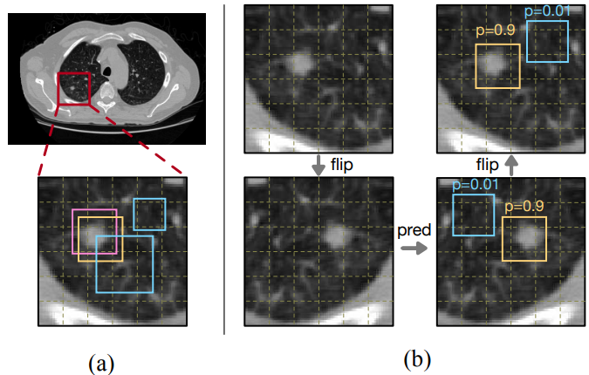
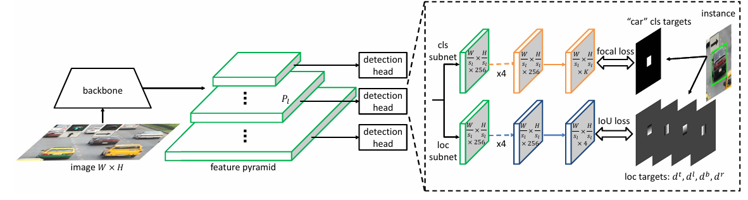
1.2 Related Works – Soft Anchor-Point Object Detection (1/2)
Global Framework of Soft Anchor-Point Object Detection (SAPD) (Training)
1. Backbone: Feature extraction using ResNet50
2. Neck: Feature pyramid network (p3-p7)
3. Head: Comprises two distinct branches for each head (input p3-p7):
1) Classification Branch (cls subnet): Perform object category classification,
Classification Map $\hat{C}$={$\hat{c_{lij}}$}: confidence socre $\hat{c_{lij}}$is an 80-D vector (79(fg)+1(bg) classes)
Loss: Focal loss $=α_{t}{\left(1−p_{t}\right)}^{γ}CE(p,p^{∗})$
2) Regression Branch (loc subnet): Estimate the 4 direction distances (offset) to the boundaries of an object,
4 Coordinate Maps $\hat{D}$={$\hat{D_{k}}$},k=l,t,r,b； $\hat{D_{k}}$={$\hat{{ d}_{lij}^{k}}$}
$\hat{d_{lij}^{l}}\hat{{ d}_{lij}^{t}} \hat{d_{lij}^{r}} \hat{d_{lij}^{b}}$ is predict left/top/right/bottom relative offsets
Loss: $IoU loss=1−\frac{GT∩RP}{GT∪RP}$
$p_{l}$: l-th pyramid level
(i,j): grid point location
$c_{lij}$: GT object category
$d_{lij}=$($d_{lij}^{l}$, $d_{lij}^{t}$, $d_{lij}^{r}$, $d_{lij}^{b}$)
$d_{lij}^{l}$, $d_{lij}^{t}$, $d_{lij}^{r}$, $d_{lij}^{b}$: GT left/top/right/bottom relative offsets
$$B$$
Alan:
B: GT bbox
$B_{v}:$ a central shrunk (0.5) box of B
𝑝_𝑙𝑖𝑗: an anchor point pixel on the pyramid level P_l located at (i, j)
Anchor pt+ = grid pt inside Bv
Anchor pt- = grid pt outside Bv
$$B_{v}$$
Backbone:
Feature Extraction using ResNet50
2. Neck:
Feature Pyramid Network
3. Head (Ex. input p5)
$$\hat{C}$$
1)
p5
25x32x256c
25x32x256c
25x32x80c (80 classes)
$$\hat{D}$$
2)
25x32x256c
25x32x256c
25x32x4c (4 direction )
l=3~7: Pyramid level p3~p7
(I,j): Anchor pt = grid pt,
exp. P5 (I,j)=(0~24,0~31)
Total loss: $L=\frac{1}{\sum_{p_{lij}∈p^{+}}{w_{lij}}}\sum_{lij}{w_{lij}L_{lij}}$
$$L_{lij}= \left\{\begin{aligned}l_{FL}\left(\hat{c_{lij}}, c_{lij}\right)+l_{IoU}\left(\hat{d_{lij}}, d_{lij}\right), p_{lij}∈p^{+} \\ l_{FL}\left(\hat{c_{lij}}, c_{lij}\right),p_{lij}∈p^{−}\end{aligned}\right.$$
p5
weight for each anchor pt plij
Input
Alan: weight $w_{lij}$, 會針對每一個anchor point產生出的loss去做加權，詳細的作法會在3.2介紹
Fig.2: The network architecture of a vanilla anchor-point detector with a simple detection head.

Slide 9
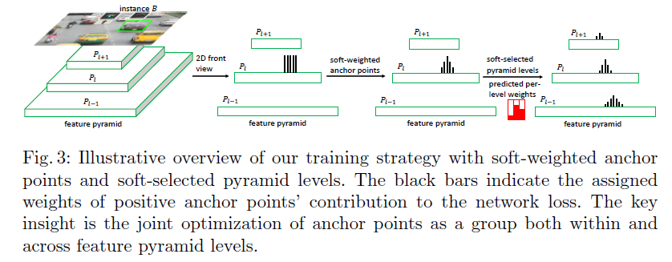
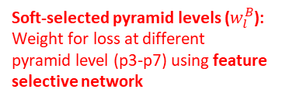
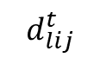
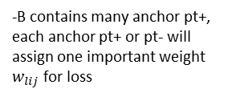
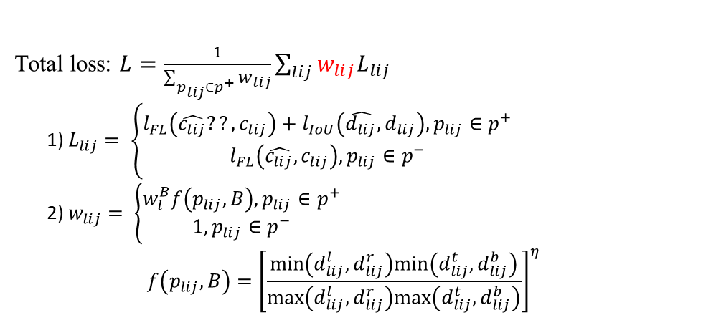
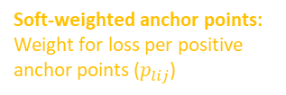
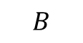
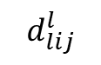
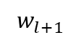
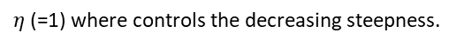
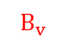
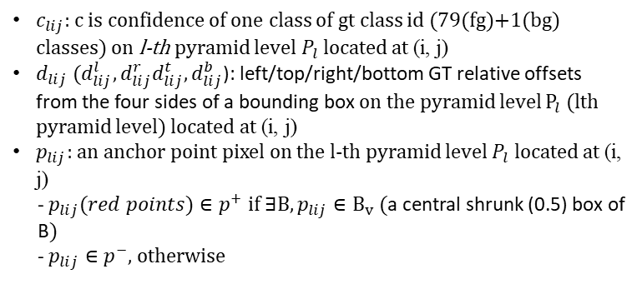
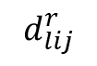

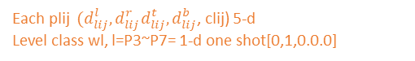

1.2 Related Works – Soft Anchor-Point Object Detection (2/2)
Each plij ${ (d}_{lij}^{l},d_{lij}^{r}d_{lij}^{t},d_{lij}^{b}$, clij) 5-d
Level class wl, l=P3~P7= 1-d one shot[0,1,0.0.0]
$c_{lij}:$c is confidence of one class of gt class id (79(fg)+1(bg) classes) on l-th pyramid level$P_{l}$located at (i, j)
${d_{lij} (d}_{lij}^{l},d_{lij}^{r}d_{lij}^{t},d_{lij}^{b}$): left/top/right/bottom GT relative offsets from the four sides of a bounding box on the pyramid level $P_{l}$(lth pyramid level) located at (i, j)
$p_{lij}$: an anchor point pixel on the l-th pyramid level $P_{l}$ located at (i, j)
- $p_{lij}(red points)∈p^{+} if ∃B, p_{lij}∈B_{v}$ (a central shrunk (0.5) box of B)
- $p_{lij}∈p^{−}$, otherwise
Total loss: $L=\frac{1}{\sum_{p_{lij}∈p^{+}}{w_{lij}}}\sum_{lij}{w_{lij}L_{lij}}$
1) $L_{lij}= \left\{\begin{aligned}l_{FL}\left(\hat{c_{lij}}??, c_{lij}\right)+l_{IoU}\left(\hat{d_{lij}}, d_{lij}\right), p_{lij}∈p^{+} \\ l_{FL}\left(\hat{c_{lij}}, c_{lij}\right),p_{lij}∈p^{−}\end{aligned}\right.$
2) $w_{lij}= \left\{\begin{aligned}w_{l}^{B}f\left(p_{lij}, B\right),p_{lij}∈p^{+} \\ 1,p_{lij}∈p^{−}\end{aligned}\right.$
$$f\left(p_{lij}, B\right)={\left[\frac{min\left(d_{lij}^{l},d_{lij}^{r}\right)min\left(d_{lij}^{t},d_{lij}^{b}\right)}{max\left(d_{lij}^{l},d_{lij}^{r}\right)max\left(d_{lij}^{t},d_{lij}^{b}\right)}\right]}^{η}$$
weight for each anchor pt plij
Focal loss
?
IoU loss
?
?
Anchor pt+ = grid pt inside Bv
Anchor pt = grid pt outside Bv
$$B$$
- l=3~7: Pyramid level p3~p7
- (I,j): Anchor pt = grid pt, exp. P5 (I,j)=(0~24,0~31)
$$B_{v}$$
Alan: f(．)接近1代表anchor point越接近instance中心點，反之越小代表越接近instance邊界。
$η$(=1) where controls the decreasing steepness.
-B contains many anchor pt+, each anchor pt+ or pt- will assign one important weight $w_{lij}$ for loss
J: Pyramid Level classification
Soft-weighted anchor points: Weight for loss per positive anchor points ($p_{lij}$)
Soft-selected pyramid levels ($w_{l}^{B}$):
Weight for loss at different pyramid level (p3-p7) using feature selective network
$$B$$
$$d_{lij}^{t}$$
(i, j)
(x,y)
$$d_{lij}^{l}$$
$$d_{lij}^{r}$$
Weight for p+ (全部都相同)
Weight for p+ (接近中心的權重愈高)
Weight for p+
(每一層level有不同的權重)
$$d_{lij}^{b}$$
Fig.3: Illustrative overview of our training strategy with soft-weighted anchor points and soft-selected pyramid levels. The black bars indicate the assigned weights of positive anchor points contribution to the network loss. The key insight is the joint optimization of anchor points as a group both within and across feature pyramid levels.
$$w_{l+1}$$

Slide 10












1.2 Related Works – Label Assignment Matters (1/2)
Global Framework
3.1)
H x W / s (stride)
200x200 x128c
$$\hat{P}$$
25x25 /32
50x50 /16
200x200 x128c
Conv 3x3x128x128 ➔ 200x200x128c
Conv 1x1x128x8 ➔ 200x200x8 (classes)c
100x100 /8
3.2)
$$\hat{R}$$
200x200 x128c
Conv 1x1x128x4 ➔ 200x200x4c
200x200 /4
200x200 x128c
Conv 3x3 ➔ 200x200x64c
GIoU loss
800x800 /1
1.
2.
3.
Backbone: Feature extraction using ResNet50
Input: Image (灰階圖) I (800x800x1c)
Output: Feature Mapes (C2-C5)
Shortcut (neck): Integration (element-wise addition) of feature maps with varying resolutions
Input: Feature Mapes (C2-C5)
Output: Feature maps (200x200x128c)
Head: Comprises two distinct branches:
3.1) Localization & Classification (segment) Branch: Evaluate object category classification.
Label assign method: Gaussian Assignment (GA)
$p_{x,y}:$ grid point
$p_{x,y}∈p+$ positive point, if Gaussian heatmap value $Y(x,y)$ >= $α (=0.1)$
$p_{x,y}∈p−$ negative point, if Gaussian heatmap value $Y(x,y)$< $α \left(=0.1\right)$
Input: Output of Shortcut (200x200x128c)
Output: 8(classes) Classification Map $\hat{P}=\left\{{\hat{p}}_{x,y}^{c}\right\}$ for grid (x,y), for c-th category
${\hat{ p}}_{x,y}^{c}$: Predicted c-th class probability
Loss: $L_{cls}:$Variant Focal Loss
3.2) Regression Branch: Estimate the shape regression and offset of an object
Input: Output of Shortcut (200x200x128c)
Output: 4 Regression Map $\hat{R} =\left\{{\hat{R}}_{x,y}^{k}\right\},k=width, hight, offset_{x}, offset_{y}$
${\hat{R}}_{x,y}^{k}$: Predicted bbox shape regression or offset
${\hat{B}}_{x,y}:$Predicted bbox ($\hat{x_{1}}, \hat{y_{1}},\hat{x_{2}}, \hat{y_{2}}$) encode from ${\hat{R}}_{x,y}^{k}$
Loss: $L_{reg}:GIoU$ loss
4. Total loss:
$L\left(\hat{P},\hat{R}\right)={w_{cls}L}_{cls}+{w_{reg}L}_{reg}, w_{cls}=1, w_{reg}=4$
S: stride (=4)
(x, y): coordinate of grid point, 1 grid = 4x4 pixel
Ex: grid (1, 1) 對應pixel 座標 (1*4, 1*4)
m: GT bbox index in image I, m=$1\sim M$
$B_{m}$: m-th GT bbox ($x_{1}, y_{1},x_{2}, y_{2}$, c)
($c_{x}^{m},c_{y}^{m}$)=($\frac{x_{1}+x_{2}}{2∗s},\frac{y_{1}+y_{2}}{2∗s}$), the center of m-th GT bbox
$h^{m}, w^{m}$=($\frac{x_{2}−x_{1}}{s},\frac{y_{2}−y_{1}}{s}$), the width and height of m-th GT bbox
c: object category (0-7, 共8類不包含backgrond)
$Y\text{ = }Max\left({\{Y}_{m}\}\right),m=1\sim M:$ $Y$Gaussian heatmap (200x200x1c),
> $Y_{m}\left(x,y\right)$ = $f\left(X|μ\text{, }Σ\right)$=N($μ$, $Σ$), grid (x,y) at m-th gaussian target heatmap
$\text{PDF} \text{of} \text{a} \text{2}\text{D} \text{Gaussian} \text{distribution}$
$f\left(X|μ\text{, }Σ\right)= \frac{exp(−\frac{1}{2}{\left(X − μ\right)}^{T} Σ^{−1} (X − μ))}{\left(2π\right){\left|Σ\right|}^{\frac{1}{2}}}$
$X= \left[\begin{aligned}x \\ y\end{aligned}\right]$
$μ= \left[\begin{aligned}c_{x} \\ c_{y}\end{aligned}\right]$
$Σ= \left[\begin{matrix}σ_{w}^{2} & 0 \\ 0 & σ_{h}^{2}\end{matrix}\right]$
$σ_{w}= \left\{\begin{aligned}\frac{w}{6}, if w<β(=4 grid (16 pixel)) \\ \frac{β}{6} (grid), otherwise \end{aligned}\right.$
$σ_{h}= \left\{\begin{aligned}\frac{h}{6}, if h<β(=4) \\ \frac{β}{6} \left(grid\right) , otherwise \end{aligned}\right.$
the mean vector of Gaussian distribution of GT bbox
the covariance matrix of Gaussian distribution
($c_{x}, c_{y}$)
$$f\left(X\right)$$
Alan:
- $β$ 用來調整物件最大的正樣本數量。
- EX: alpha = 0.1, $Y(x,y)$ > alpha → positive sample
估算距離中心點 1.32 (grid), heatmap value $≅$ 0.1， EX: $f\left((1.32, 0)\right)≅0.1$
- 因此可以粗略得知任一物件最多只會有(1.32)²π ≈ 9個正樣本，
Alan:預測框的左上角和右下角
$$α=0.1$$
w
h

Slide 11














1.2 Related Works – Label Assignment Matters (2/2)
S: stride (=4)
(x, y): coordinate of grid point, 1 grid = 4x4 pixel
Ex: grid (1, 1) 對應pixel 座標 (1*4, 1*4)
m: GT bbox index in image I, m=$1\sim M$
$B_{m}$: m-th GT bbox ($x_{1}, y_{1},x_{2}, y_{2}$, c)
($c_{x}^{m},c_{y}^{m}$)=($\frac{x_{1}+x_{2}}{2∗s},\frac{y_{1}+y_{2}}{2∗s}$), the center of m-th GT bbox
$h^{m}, w^{m}$=($\frac{x_{2}−x_{1}}{s},\frac{y_{2}−y_{1}}{s}$), the width and height of m-th GT bbox
c: object category (0-7, 共8類不包含backgrond)
$Y\text{ = }Max\left({\{Y}_{m}\}\right),m=1\sim M:$ $Y$Gaussian heatmap (200x200x1c),
> $Y_{m}\left(x,y\right)$ = $f\left(X|μ\text{, }Σ\right)$=N($μ$, $Σ$), grid (x,y) at m-th gaussian target heatmap
Total loss: $L\left(\hat{P},\hat{R}\right)=wL_{cls}+wL_{reg}$
$L_{cls}:variant focal loss$
$L_{cls}=−\frac{1}{M}\sum_{xyc}{\left\{\begin{aligned} {\left(1−{\hat{p}}_{x,y}^{c}\right)}^{γ}\log\left({\hat{p}}_{x,y}^{c}\right), if p_{x,y} ∈p+ \\ {\left(1−Y_{x,y.c}\right)}^{η}{\left({\hat{p}}_{x,y}^{c}\right)}^{γ}∗\log\left(1−{\hat{p}}_{x,y}^{c}\right), otherwise\end{aligned}\right.}$
${\hat{ p}}_{x,y}^{c}$: Predicted class probability of specific category c
$γ(=2)$: the tunable focusing parameter, decide down-weight degree.
${\left(1−Y_{x,y.c}\right)}^{η}$ : the reweighting coefficient for negative point, the closer to the center, the smaller the value.
- $η$: the tunable focusing parameter, decide down-weight degree.
$L_{reg}:GIoU loss$
$L_{reg}$ =$−\frac{1}{N_{reg}}\sum_{xy∈A_{m}}{GIoU\left({\hat{B}}_{xy},B_{m}\right)∗W_{xy}}$
$B_{m}$: m-th GT bbox annotation ($x_{1}, y_{1},x_{2}, y_{2}$)
${\hat{B}}_{x,y}:$ Predicted bbox ($\hat{x_{1}}, \hat{y_{1}},\hat{x_{2}}, \hat{y_{2}}$)
$A_{m}$ : Gaussian-area, $Y_{m}$> 0, include m-th GT bbox
$N_{reg}$ : The number of regression target, the area of $A_{m}$
$W_{x,y}$ = $\left\{\begin{aligned}\log\left(a_{m}\right)∗\frac{Y_{m}\left(x,y\right)}{\sum_{ij∈A_{m}}{Y_{m}(i,j})} if (x,y)∈A_{m} \\ 0. otherwise\end{aligned}\right.$
$a_{m}$: the area of the m-th bbox $B_{m}$
Focal loss
$\text{PDF} \text{of} \text{a} \text{2}\text{D} \text{Gaussian} \text{distribution}$
$f\left(X|μ\text{, }Σ\right)= \frac{exp(−\frac{1}{2}{\left(X − μ\right)}^{T} Σ^{−1} (X − μ))}{{\left(2π\right)}^{\frac{n}{2}} {\left|Σ\right|}^{\frac{1}{2}}}$
$X= \left[\begin{aligned}x \\ y\end{aligned}\right]$
$μ= \left[\begin{aligned}c_{x} \\ c_{y}\end{aligned}\right]$
$Σ= \left[\begin{matrix}σ_{w}^{2} & 0 \\ 0 & σ_{h}^{2}\end{matrix}\right]$
$σ_{w}= \left\{\begin{aligned}\frac{w}{6}, if w<β(=4 grid (16 pixel)) \\ \frac{β}{6} (grid), otherwise \end{aligned}\right.$
$σ_{h}= \left\{\begin{aligned}\frac{h}{6}, if h<β(=4) \\ \frac{β}{6} \left(grid\right) , otherwise \end{aligned}\right.$
Alan: ${\left(1−Y_{x,y.c}\right)}^{η}$ →
Purpose: 減少那些因空間位置非常靠近真實物體中心，從而容易讓模型混淆 (confusing)、難以明確區分為背景的負樣本，對訓練過程造成的干擾。
Method: 根據負樣本點 (x, y) 與GT bbox 中心 的接近程度（反映在$Y_{x,y.c}$值上），利用 ${\left(1−Y_{x,y.c}\right)}^{η}$計算出一個調節係數，動態地降低靠近中心的負樣本在損失計算中的權重。
the mean vector of Gaussian distribution of GT bbox
the covariance matrix of Gaussian distribution
$$f\left(X\right)$$
($c_{x}, c_{y}$)
($c_{x}, c_{y}$)
$$α=0.1$$
w
h
Alan:
- $β$ 決定高斯分布最大的變異數，用來調整物件最大的正樣本數量。
- EX: alpha = 0.1, $Y(x,y)$ > alpha → positive sample
根據估計，大約距離中心點 1.32 (grid), heatmap value $≅$ 0.1， EX: $f\left((1.32, 0)\right)≅0.1$
- 因此可以粗略得知任一物件最多只會有(1.32)²π ≈ 9個正樣本，
Log(am)
大物件
小物件
am
Alan: $W_{x,y}$→
$\frac{Y_{m}\left(x,y\right)}{\sum_{ij∈A_{m}}{Y_{m}(i,j})}$: 強調中心點附近的sample(高質量), 減少模型被低品質的sample對訓練過程造成的干擾。
$\log\left(a_{m}\right)$:高斯正規化使大框和小框總權重均等，但忽略了大物件有多的資訊(應該要有較高的權重)。
Ex: $a_{m}$=10000 (大物件) vs. $a_{m}$=100 (小物件)
$log⁡(10000)\text{≈}\text{9.2}$, $\log\left(100\right)\text{≈}\text{4.6}$, (log 用來調整大物件和小物件的權重比例, 如果直接乘上am 會導致小物件被忽略)

Slide 12
2.1 System Setup

Slide 13
2.2 Specification of Hardware and Function

Slide 14





3.1.1 Framework of Training Process
Backbone:
Feature Extraction using ResNet50
2. Neck:
Feature Pyramid Network
3. Head (Ex. input p4)
6x6x6 /16
C5
P5
1) cls subnet
x4
$$\hat{P}$$
12x12x12 /8
C4
P4
HxWxDx1c (1(fg)/0(bg))
HxWxDx256
HxWxDx256
x6
24x24x24 /4
C3
P3
$$\hat{D}$$
x4
$$\hat{D_{k}}$$
$$\hat{D_{k}′}$$
C2
P2
2) loc subnet
HxWxDx102c
(6 directions x 17 bins 102)
integral
48x48x48 /2
Alan:
Pyramid Level (L) 越大，解析度越小，適合預測大物件
Pyramid Level (L) 越小，解析度越高，適合預測小物件
分析：Nodule 多為小物件，因此選用 P2-P4。
HxWxDx256
HxWxDx256
96x96x96
17個bin (0-16)
height x width x depth /$stride_{l}$
Classification & IoU Branch + Regression Branch
1. Backbone: Feature extraction using ResNet50
2. Neck: Feature pyramid network (p2-p4)
3. Head: Comprises two distinct branches for each head (input p2-p4):
1) Classification & IoU Joint Branch (cls subnet): Evaluate object category classification while incorporating location quality (IoU score).
Classification & IoU Joint Score Map $\hat{P}=\left\{\hat{p_{x,y,z}}\right\}:\hat{p_{x,y}}$ is an 1-D (1(fg)/0(bg)) vector, where each dimension represents the likelihood of the point (x, y) belonging to a specific class, incorporating both classification confidence and localization quality (IoU score)
Loss: $L_{Q}$Quality Focal Loss (QFL)
2) Regression Branch (loc subnet): Estimate the 4 direction distances (offset) to the boundaries of an object
4 Coordinate distribution Map $\hat{D} =\{\hat{D_{k}} \},k=l,t,r,b\text{, }\text{f}\text{ (}\text{font}\text{), }\text{bk}\text{ (}\text{backward}\text{),}\text{；} \hat{D_{k}} \text{=\{}\hat{{ d}_{x,y,z}^{k}}\text{\}}$
$\hat{d_{x,y,z}^{k} }$ $=\{\hat{d_{x,y,z}^{ki} }\}$ is a discrete probability distribution represented as an (17 (n+1)-D vector) vector of the point (x, y, z) . Each element $\hat{d_{x,y,z}^{ki} }$ corresponds to the predicted probability of the value falling within a specific bin, where the discretized range is defined as$\left\{y_{0}\left(=0\right), y_{1}\left(=1\right), …,y_{i}\left(=i\right), …,y_{n−1}\left(=15\right),y_{n}\left(=16\right)\right\}$, given n(=16) and bin width $Δ$(=1).
Loss: $L_{D}$Distribution Focal Loss (DFL)
4 Coordinate Map $\hat{D′} =\{\hat{{D′}_{k}} \},k=l,t,r,b\text{, }\text{f}\text{, }\text{bk}\text{；} \hat{{D′}_{k}} \text{=\{}\hat{{ d}_{x,y,z}^{k′}}\text{\}}$
$\hat{d_{x,y,z}^{k′} }$ = $\sum_{i=0}^{n}{\hat{d_{x,y,z}^{ki} }}∗y_{i}$: The k-direction distance of a bounding box to the location (x,y,z)
Loss: IoU loss = 1 - $\frac{GT∩RP}{GT∪RP}$
4. Total loss: $L\left(\hat{P},\hat{D}\right)=\frac{1}{N_{pos}}\sum_{x,y}{L_{Q}}+\frac{1}{N_{pos}}\sum_{x,y,z}{1\left\{c_{x,y,z}^{∗}>0\right\}\left(λ_{0}IoU(\hat{d_{x,y,z}^{k′} },d_{x,y,z}^{k∗})+λ_{1}L_{D}\right)}$
?
Alan: 以P4 當作輸入為例
(x, y) = (0~7, 0~7)
?
$c_{x,y,z}^{∗}$: GT object category (1(fg)/0(bg))
($d_{xy,z}^{l}$, $d_{xy,z}^{t}$, $d_{xy,z}^{r}$, $d_{xy,z}^{b},d_{xy,z}^{f}$, $d_{xy,z}^{bk}$) : GT relative offsets from the six sides of a bounding box located at (x, y, z)
$d_{x,y,z}^{k∗}=$($d_{xyz}^{l‘}$, $d_{xyz}^{t’}$, $d_{xyz}^{r‘}$, $d_{xyz}^{b’}$ , $d_{xyz}^{f’}$ , $d_{xyz}^{bk’}$): normalizing regression targets by corresponding strides, ex: $d_{xyz}^{l‘}$ = $d_{xyz}^{l}$ / $stride_{l}$ (l-th stride)
Alan: 求distribution 的期望值,將分布轉換成一個數值
$$d_{xy}^{t}$$
integral
(x,y)
$$d_{xy}^{l}$$
$$d_{xy}^{r}$$
alan： 技巧: 每一層的pyramid level 輸出的regression target $d_{x,y,z}^{k∗}$ 都會除上stride 做 normalize, 降低每一層的差異。
$$d_{xy}^{b}$$

Slide 15



3.1.2 Framework of Inference Process
Backbone:
Feature Extraction using ResNet50
2. Neck:
Feature Pyramid Network
3. Head (Ex. input p4)
6x6x6 /16
C5
P5
1) cls subnet
x4
$$\hat{P}$$
12x12x12 /8
C4
P4
HxWxDx1c (1(fg)/0(bg))
HxWxDx256
HxWxDx256
x6
24x24x24 /4
C3
P3
$$\hat{D}$$
x4
$$\hat{D_{k}}$$
$$\hat{D_{k}′}$$
C2
P2
2) loc subnet
HxWxDx102c
(6 directions x 17 bins 102)
integral
48x48x48 /2
Alan:
Pyramid Level (L) 越大，解析度越小，適合預測大物件
Pyramid Level (L) 越小，解析度越高，適合預測小物件
分析：Nodule 多為小物件，因此選用 P2-P4。
HxWxDx256
HxWxDx256
96x96x96
17個bin (0-16)
height x width x depth /$stride_{l}$
Classification & IoU Branch + Regression Branch
x6
1. Backbone: Feature extraction using ResNet50
2. Neck: Feature pyramid network (p2-p4)
3. Head: Comprises two distinct branches for each head (input p2-p4):
1) Classification & IoU Joint Branch (cls subnet): Evaluate object category classification while incorporating location quality (IoU score).
Classification & IoU Joint Score Map $\hat{P}=\left\{\hat{p_{x,y,z}}\right\}:\hat{p_{x,y}}$ is an 1-D (1(fg)/0(bg)) vector, where each dimension represents the likelihood of the point (x, y) belonging to a specific class, incorporating both classification confidence and localization quality (IoU score)
2) Regression Branch (loc subnet): Estimate the 4 direction distances (offset) to the boundaries of an object
4 Coordinate distribution Map $\hat{D} =\{\hat{D_{k}} \},k=l,t,r,b\text{, }\text{f}\text{ (}\text{font}\text{), }\text{bk}\text{ (}\text{backward}\text{),}\text{；} \hat{D_{k}} \text{=\{}\hat{{ d}_{x,y,z}^{k}}\text{\}}$
$\hat{d_{x,y,z}^{k} }$ $=\{\hat{d_{x,y,z}^{ki} }\}$ is a discrete probability distribution represented as an (17 (n+1)-D vector) vector of the point (x, y, z) . Each element $\hat{d_{x,y,z}^{ki} }$ corresponds to the predicted probability of the value falling within a specific bin, where the discretized range is defined as$\left\{y_{0}\left(=0\right), y_{1}\left(=1\right), …,y_{i}\left(=i\right), …,y_{n−1}\left(=15\right),y_{n}\left(=16\right)\right\}$, given n(=16) and bin width $Δ$(=1).
4 Coordinate Map $\hat{D′} =\{\hat{{D′}_{k}} \},k=l,t,r,b\text{, }\text{f}\text{, }\text{bk}\text{；} \hat{{D′}_{k}} \text{=\{}\hat{{ d}_{x,y,z}^{k′}}\text{\}}$
$\hat{d_{x,y,z}^{k′} }$ = $\sum_{i=0}^{n}{\hat{d_{x,y,z}^{ki} }}∗y_{i}$: The k-direction distance of a bounding box to the location (x,y,z)
Postprocess (input $\hat{P}$+ $\hat{D′}$)
(1) $\hat{{D′′}_{k}} \text{=\{}\hat{{ d}_{x,y}^{k′′}} \}, \hat{d_{x,y}^{k′′} }$ = $\hat{d_{x,y}^{k′} }∗stride_{l}$:The k-direction distance from a bounding box to the location (x,y), scaled by the stride of multiple specific pyramid levels $stride_{l}$.
(2) Predict box ($x_{top,left,bottom}$, $y_{top,left,backward,}$, $z_{top,left,backward,}$w, h, d, c): (x $−\hat{d_{x,y,z}^{l′′} }$, y $−\hat{d_{x,y,z}^{t′′} }$ , $z−\hat{d_{x,y,z}^{bk′′} }$,$\hat{d_{x,y,z}^{l′′} }+\hat{d_{x,y,z}^{r′′} }$,$\hat{d_{x,y,z}^{t′′} }+\hat{d_{x,y,z}^{b′′} }$, $\hat{d_{x,y,z}^{f′′} }+\hat{d_{x,y,z}^{bk′′} }$ $\hat{p_{x,y,z}}$).
(3) Perform NMS by Classification & IoU Joint Score $\hat{p_{x,y.z}}$as NMS score
(3.1) Selecting 120 top-scoring $\hat{p_{x,y,z}}$anchor points in each pyramid level.
(3.2) keep $\hat{c_{lij}}≥$ 0.05 (threshold)
(3.3) non-maximum suppression with a iou threshold of 0.1
3) Postprocess using NMS
$$\hat{D′}′$$
* $stride_{l}$
?
Alan: 以P4 當作輸入為例
(x, y) = (0~7, 0~7)
?
Alan: 求distribution 的期望值,將分布轉換成一個數值
integral

Slide 16




3.1.3 Loss Function
Classification & IoU Joint Score
Bounding Regression
Total loss: $L\left(P′, T,Ctr\right)=\frac{1}{N_{pos}}\sum_{x,y}{L_{Q}}+\frac{1}{N_{pos}}\sum_{x,y}{1\left\{c_{x,y}^{∗}>0\right\}\left(λ_{0}(=4)L_{reg}(o_{x,y},o_{x,y}^{∗})+λ_{1}(=1)L_{D}\right)}$
$L_{Q}$: Quality Focal Loss (QFL):
${\left|y−σ\right|}^{β}$: scaling factor, automatically down-weights the contribution of easy examples during training and rapidly focuses the model on hard example.
$y∈\left[0, 1\right],$IoU score between the predicted bounding box and its corresponding ground-truth bounding box during training.
$σ$ $∈\left[0, 1\right],$denotes the estimated probability for nodule.
$β(=2)$is the tunable focusing parameter, decide down-weight degree.
$−(\left(1−y\right)\log\left(1−σ\right)+ylog(σ))$: binary cross entropy.
Input: (Classification & IoU Joint Score Map P’)
1) Scaling factor
2) Binary Cross entropy
Alan: predicted bbox is from loc subnet
Alan:$β$值越大對於outliner 越不敏感。
Fig. (a)

Slide 17










3.1.3 Loss Function
Classification & IoU Joint Score
Bounding Regression
Total loss: $L\left(P′, T,Ctr\right)=\frac{1}{N_{pos}}\sum_{x,y}{L_{Q}}+\frac{1}{N_{pos}}\sum_{x,y}{1\left\{c_{x,y}^{∗}>0\right\}\left(λ_{0}(=4)L_{reg}(o_{x,y},o_{x,y}^{∗})+λ_{1}(=1)L_{D}\right)}$
$L_{D}$: Distribution Focal Loss(DFL):
${ y}_{i}$, $y_{i+1}$: the bins adjacent to the regression target y.
For example, if y = 4.6 then$y_{i}$= 4 and $y_{i+1​}$=5
$P\left(x\right)$: (Fig a) general distribution (discrete probability distribution).
with a discretizing range of $\{y_{0}\left(=0\right), y_{1}\left(=1\right), …,y_{n−1}\left(=15\right),y_{n}(=16)\}$ based on n(=16) and $Δ$(=1)
$S_{i}, S_{i+1}:$ probability of yi and yi+1
Cross entropy
Alan: 為什麼沒有scaling factor,因為bounding regression只有在positive sample才做計算，因此不會有正負樣本不均衡的問題。
Alan: = output of loc subnet, 用來產生bbox 資訊
Alan: $S_{i}$ 和$P\left(y_{i}\right)$ 的定義是相同的，跟隨論文定義
預測出來的distribution越尖銳代表模型對於越測結果越有信心(like fig. (b)(3))，要如何設計loss function，讓模型可以產生較佳的distribution
強調regression target y 相鄰 bins $y_{i}$ 和 $y_{i+1}$產生的機率，其餘bins的機率皆為0，
- predicted regression $\hat{y}$= $\sum_{j=0}^{n}{S_{j}y_{j}}$, 可以表示成$\hat{y} =S_{i}y_{i}+S_{i+1}y_{i+1}$。
可以從$\hat{y} =S_{i}y_{i}+S_{i+1}y_{i+1}$, $S_{i}$ + $S_{i+1}$=1 得到全域最佳解 $S_{i}$ =$y_{i+1}−y$, $S_{i+1}$ =${y − y}_{i}。$
Fig. (a)
Fig. (b)
t
l
r
b
$$y_{0}$$
$$y_{i+1}$$
$$y_{n}$$
$$y_{i}$$
$$y$$

Slide 18






Dirac delta distribution $δ(x−y)$:
Prior condition: It is equal to zero at all points except $y$
It satisfies $\int_{−∞}^{+∞}{δ\left(x−y\right)dx}=1$
The integral form to recover $y$, $y=\int_{−∞}^{+∞}{δ\left(x−y\right)xdx}$
General distribution $P\left(x\right):$
Prior condition: None
It satisfies $\int_{−∞}^{+∞}{δ\left(x−y\right)dx}=1$
The integral form to recover $y$, $y$ =$\int_{−∞}^{+∞}{P\left(x\right)xdx}$=$\int_{y_{0}}^{y_{n}}{P\left(x\right)xdx}$
$y_{0}$: minimum value of $y$ (label)
$y_{n}$: maximum value of $y$ (label), ($y_{0}≤y≤y_{n}, n∈ℕ^{+}$)
Convert the integral over the continuous domain into a discrete representation
(To be consistent with convolutional neural networks)
Continuous range [$y_{0,}y_{n}$]➔Discretizing range, $\{y_{0}, y_{1}, …,y_{n−1},y_{n}$} based on n(=16) and $Δ$(=1)
$y$=$\int_{y_{0}}^{y_{n}}{P\left(x\right)xdx}$➔$y=\sum_{i=0}^{n}{P\left(y_{i}\right)y_{i}}$
t
l
r
$$y=r_{xy}$$
b
Alan: 其實模型學習的是distribution
Continuous representation
t
l
r
b
Alan:根據不同資料集有不同的range($y_{0}$, $y_{n}$)
Discrete representation
t
l
r
b
$$y_{0}$$
$$y_{n}$$

Slide 19

3.1.3 Loss Function
Classification & IoU Joint Score
Bounding Regression
Total loss: $L\left(P′, T,Ctr\right)=\frac{1}{N_{pos}}\sum_{x,y}{L_{Q}}+\frac{1}{N_{pos}}\sum_{x,y}{1\left\{c_{x,y}^{∗}>0\right\}\left(λ_{0}(=4)L_{reg}(o_{x,y},o_{x,y}^{∗})+λ_{1}(=1)L_{D}\right)}$
3. $L_{reg}$: GIoU Loss

Slide 20


3.1.3 Loss Function: Conclusion
Generalized Focal Loss (GFL):
$y_{l}, y_{r}:$ Target value, ensure that ($y_{l}<y_{r})$
$p_{yl}, p_{yr}:$ Model estimates probabilities for two variables $y_{l}, y_{r}$, ensure that ($p_{yl},≥0, p_{yr}≥0, p_{yl},+p_{yr}=1$)
$\hat{y}$: Final prediction, $\hat{y}$ = $y_{l}p_{yl}+y_{r}p_{yr}$ ($y_{l}≤\hat{y}≤y_{r}$)
FL, QFL and DFL are special cases of GFL

Slide 21






3.2 IoU-based Loss (1/2)
Ray
Original IoU Loss
Advantage: 能夠利用overlapping部分，判斷RP的好壞
Drawback: IoU相同，但形狀、與GT中心距離不同，將被視為一樣好
GIoU Loss
Advantage: 利用overlapping 、 non-overlapping判斷RP的好壞，增加衡量精準
Drawback: 當RP、GT有包含關係時(non-overlapping範圍為0)，退化為IoU Loss
DIoU Loss
Advantage: 利用overlapping、RP與GT中心點距離進行判斷，改善GIoU，RP在GT內退化為IoU Loss問題
Drawback: 無法分辨與GT中心點距離相同的RP好壞
$$L_{reg}$$
Non-overlapping
MBR: 能夠同時框住GT、RP的最小矩形
MBR包含白色區域
GT、RP不包含白色區域
RP: Region proposal
GT: Ground truth
藍框: ground truth
綠框: region proposal
d: distances between the center points of RP and GT,
c: diagonal length of the Minimum Bounding Rectangle (MBR) of RP and GT

Slide 22





3.2 IoU-based Loss (2/2)
Ray
CIoU Loss
Advantage: 基於DIoU Loss，加上aspect ratio，判斷RP好壞，增加分辨中心點位置相同的RP好壞的能力
Drawback: arctan計算複雜度較大，且無法分辨RP、GT長寬比例相同的情況
VDIoU Loss
Advantage: VDIoU 收斂快速，計算量小，且能分辨中心點不同、長寬比例不同的情況
d: distances between the center points of RP and GT,
c: diagonal length of the Minimum Bounding Rectangle (MBR) of RP and GT
wGT, hGT: width and height of GT,
wRP, hRP width and height of RP.
Why arctan?
AE, BF, CG, DH: distances between the four vertices of RP and GT,
XY: diagonal length of the Minimum Bounding Rectangle (MBR) of RP and GT
VDIoU:

Slide 23

4.1.1 Data Collection
Table 1. Me Dataset Data Split
Data_Me | Train ​(69.4%) | Val​​ (10.6%) | Test (20.0%) | Total​
Patients​ | 1127 | 172 | 323 | 1622
3D Nodules​ (顆) | 4091 | 720 | 1300 | 6111
Benign | 2764 | 523 | 951 | 4238
Probably Benign | 1058 | 159 | 286 | 1503
Probably Suspicious | 188 | 24 | 40 | 252
Suspicious | 81 | 14 | 23 | 118
Figure 1. Distribution of Nodule Types Across Different Data Splits

Slide 24
Table 2. LN Dataset Data
Data_LN | Train | Val​​ | Test | Total​
Patients​ |  |  | 892 | 892
3D Nodules​ (顆) |  |  | 1330 | 1330
Benign |  |  | 22 (1.9%) | 22 (1.9%)
Probably Benign |  |  | 252 (18.9%) | 252 (18.9%)
Probably Suspicious |  |  | 290 (21.8%) | 290 (21.8%)
Suspicious |  |  | 766 (57.6%) | 766 (57.6%)

Slide 25

4.1.2 Metrics
TP: True positive
FP: False positive
TN: True negative
FN: False negative
Recall (Sensitivity):
Purpose: 在所有實際正樣本中，模型成功檢測到正樣本的比例
Recall = $\frac{TP}{TP + FN}$ = $\frac{\left(Output=nodule\right) ∧ (GT=nodule)}{GT=nodule}$
Precision :
Purpose: 在所有模型預測為正樣本的樣本中，為實際正樣本的比例
Precision = $\frac{TP}{TP + FP}$ = $\frac{\left(Output=nodule\right) ∧ (GT=nodule)}{Total Outputs}$
F1 Score :
Purpose: Recall 與 Precision 的調和平均數，綜合考慮了兩項指標
F1 Score = $2×\frac{Recall×Precision}{Recall+Precision}$
Specificity :
Purpose: 在所有實際負樣本中，模型成功檢測到負樣本的比例
Specificity = $\frac{TN}{TN + FP}$

Slide 26

4.2 Experimental Result:
The recall of different method on ME_dataset_org and ME_dataset_recheck at 1,2 and 8 FPs/Scan in Table 3.
Draw the FROC curve in Figure 2.
- demonstrating the recall at seven predefined FPs/Scan rates: 1/8, 1/4, 1/2, 1, 2, 4, 8.
Table 3. Comparison with different method on Me_dataset.
Method | Recall (%) / Precision (%)
 | FPs/Scan=1 | FPs/Scan=2 | FPs/Scan=8
GFocal_v1_org | 66.7/70.7 | 76.0/57.9 | 89.0/28.7
GFocal_v1_recheck | 67.8/77.6 | 77.1/66.3 | 90.1/36.5
CPM-net | 59.4/72.8 | 69.1/60.9 | 84.5/32.3
Figure 2. FROC Performance on different methods

Slide 27
4.2 Experimental Results: Gfocal on ME_dataset_recheck
在FP/scan = 2，可以發現小顆的nodule (<4mm)的precision不高，代表模型容易產生出較小的fp。
Table 4. Gfocal_org Evaluated Recall & Precision on FP/scan = 2 (threshold = 0.20)
Table 5. Gfocal_recheck Evaluated Recall & Precision on FP/scan = 2 (threshold = 0.18)
Diameter D | Recall (%) | Precision (%) | F1 Score (%)
< 4mm | 66.2 | 36.7 | 47.2
≥ 4mm and < 6mm | 77.9 | 57.4 | 66.1
≥ 6mm and < 8mm | 82.0 | 78.4 | 80.2
≥ 8mm | 73.3 | 92.4 | 81.8
All nodule | 76.0 | 58.0 | 65.1
≥ 6mm nodule | 78.5 | 83.2 | 80.8
Diameter D | Recall (%) | Precision (%) | F1 Score (%)
< 4mm | 73.0 | 32.9 | 45.3
≥ 4mm and < 6mm | 79.9 | 72.8 | 75.3
≥ 6mm and < 8mm | 82.1 | 84.9 | 83.5
≥ 8mm | 71.8 | 94.0 | 81.4
All nodule | 77.4 | 66.2 | 71.4
≥ 6mm nodule | 78.3 | 87.7 | 82.8
alan: 在此比較經過醫師recheck data後的效果，可以發現
除了小顆的nodule (<4mm)以外，其餘的precision當有一定程度的提升，模型在訓練的過程中減少大量的錯誤訓練(明明是foreground，卻當成background)
觀察小顆的nodule (<4mm)，雖然precision 下降了3.8%，但是recall 提升6.8%，使用recheck dataset的模型相較於原本的模型更容易產生出小顆的fp

Slide 28
4.2 Experimental Results: GFocal on LN dataset
可以發現LN dataset Suspicious 的數量佔了大多數。
Table 6. GFocal Evaluated Recall & Precision on FP/scan = 2
Based on LN dataset (threshold = 0.32) (?? 要換成recheck)
Diameter D | Recall (%) | Precision (%) | F1 Score (%)
< 4mm | 27.3 | 4.8 | 8.2
≥ 4mm and < 6mm | 65.9 | 13.7 | 22.7
≥ 6mm and < 8mm | 90.0 | 38.7 | 54.1
≥ 8mm | 82.0 | 75.9 | 78.8
All nodule | 79.8 | 37.4 | 50.9

Slide 29






4.3 Q (1/2)
False Negative (missing)
1) 粘連 | 物體與組織器官相連或靠近，造成不易將其與組織器官分離，容易造成誤判。 Ex: 血管、肺葉、邊緣...
2) 過小 | 過小的結節容易被當成雜訊?? 詳細大小
3) 過大 | 推測是訓練資料大樣本不足，導致無法準確抓取

Slide 30





4.3 Q(2/2)
False positive (誤判)
1) 粘連 | 物體與組織器官相連或靠近，造成不易將其與組織器官分離，容易造成誤判。 Ex: 血管、肺葉、邊緣...
2) 形狀相似 | 容易將形狀相似的物體框選出來
3) blur | 物體模糊容易融入背景
Notes:
ChestCT 1066
ChestCT 1522
ChestCT 1617

Slide 31







5.1 複習
$$L_{cls}:$$
6x6x6 /16
C5
P5
1) cls subnet
x4
12x12x12 /8
C4
P4
12x12x12x256c
Conv 1x1x1 ➔12x12x12x1c
X6 direction
24x24x24 /4
C3
P3
x4
48x48x48 /2
C2
P2
2) loc subnet
Conv 1x1x1
➔12x12x12x102c
(6 directions x 17 bins =102)
12x12x12x256c
17個bin (0-16)/direction
96x96x96 /1
$$3) L_{total}=L_{cls}+L_{reg}$$
$$L_{reg}:$$
height x width x depth /$stride_{l}$
Head
Backbone: RestNet50
Feature Pyramid: FPN
Head
Cls subnet
1.1) Label assign method
(1) CPM-net [4]: Center-Point matching method
(2) Label Assignment Matters [10]: Gaussian Assignment (GA) strategy
1.2) Input
(1) Genetalized focal loss v2 [8]: classification feature → classification feature + localization feature (form loc subnet)
our
CPM-net
Label Assignment Matters
Classification feature
localization feature
20→
4(directions)*5(topk(4)+mean)
4: 4 directional offset
N=16: distribution sampling

Slide 32
5.1 複習
$$L_{cls}:$$
6x6x6 /16
C5
P5
1) cls subnet
x4
12x12x12 /8
C4
P4
12x12x12x256c
Conv 1x1x1 ➔12x12x12x1c
X6 direction
24x24x24 /4
C3
P3
x4
48x48x48 /2
C2
P2
2) loc subnet
Conv 1x1x1
➔12x12x12x102c
(6 directions x 17 bins =102)
12x12x12x256c
17個bin (0-16)/direction
96x96x96 /1
$$3) L_{total}=L_{cls}+L_{reg}$$
$$L_{reg}:$$
height x width x depth /$stride_{l}$
Head
Backbone: RestNet50
Feature Pyramid: FPN
Head
Loc subnet
2.1) box representation
Genetalized focal loss v1 [7]: Dirac delta distribution (impulse) → general distribution
SCPM [5]: rectangle → sphere
r
h
w
Rectangle (w, h)
Sphere (r)

Slide 33





5.1 複習??
$$L_{cls}:$$
6x6x6 /16
C5
P5
1) cls subnet
x4
12x12x12 /8
C4
P4
12x12x12x256c
Conv 1x1x1 ➔12x12x12x1c
X6 direction
24x24x24 /4
C3
P3
x4
48x48x48 /2
C2
P2
2) loc subnet
Conv 1x1x1
➔12x12x12x102c
(6 directions x 17 bins =102)
12x12x12x256c
17個bin (0-16)/direction
96x96x96 /1
$$3) L_{total}=L_{cls}+L_{reg}$$
$$L_{reg}:$$
height x width x depth /$stride_{l}$
Head
Backbone: RestNet50
Feature Pyramid: FPN
Head
Loss = $L_{cls}+L_{reg}$
3.1) Enhance hard case
CPM-net: Online Hard Example Mining (OHEM) for the negative samples in the classification loss $L_{cls}$
Sort the negative samples' losses in descending order, selecting the top (=100) (hard) examples to update the model, ensuring effective training on challenging negatives.
3.2) Remove / Downweigh confuse case
Soft anchor-point object detection:
Reduce the weight of edge samples based on their distance from instance boundaries to minimize the impact of low-quality samples during training. (for positive points)
Pyramid level classification to select useful pyramid level using feature selective network during training.
e.g., [0.2, 0.6, 0.1, 0.1] for levels P2 to P5.
Label Assignment Matters:
$L_{reg}$ → GIoU loss + Gaussian-based reweighting coefficient (gaussian value) for regression target
> Gaussian center is set at the ground truth bounding box center. Samples near the ground truth bounding box boundaries receive lower Gaussian values.
$L_{cls}$→ Focal loss + reweighting coefficient (1-gaussian value) for negative points
> Negative samples near the ground truth bounding box, which are often ambiguous due to overlapping with background, are assigned lower weights to reduce their impact during training..
$$f\left(p_{lij}, B\right)={\left[\frac{min\left(d_{lij}^{l},d_{lij}^{r}\right)min\left(d_{lij}^{t},d_{lij}^{b}\right)}{max\left(d_{lij}^{l},d_{lij}^{r}\right)max\left(d_{lij}^{t},d_{lij}^{b}\right)}\right]}^{η}$$
J: Bbox to center:
Symmetry is better
Alan: 兩篇論文認為靠近 bbox 中心的樣本特徵較好，邊界附近樣本因背景較多而特徵較差，因此分別提出不同方法以減少低品質樣本對訓練的干擾。
$$f\left(p_{lij}, B\right)$$
Alan: gaussian value接近GT bbox 中心點值最高，越往邊界值越小
Alan:
- Green color bbox: ground-true bbox B
Orange grid point near instance boundaries have poorly aligned features (include a lot of background information).
Red grid point near the instance center have well-aligned features.
Error: if treating orange grid point as equal to red grid point can mislead the model.
Improved: Assign different weights for loss:
Red grid point should receive higher attention.
Original grid point should receive lower attention.

Slide 34


5.1 複習
$$L_{cls}:$$
6x6x6 /16
C5
P5
1) cls subnet
x4
12x12x12 /8
C4
P4
12x12x12x256c
Conv 1x1x1 ➔12x12x12x1c
X6 direction
24x24x24 /4
C3
P3
x4
48x48x48 /2
C2
P2
2) loc subnet
Conv 1x1x1
➔12x12x12x102c
(6 directions x 17 bins =102)
12x12x12x256c
17個bin (0-16)/direction
96x96x96 /1
$$3) L_{total}=L_{cls}+L_{reg}$$
$$L_{reg}:$$
height x width x depth /$stride_{l}$
Head
Backbone: RestNet50
Feature Pyramid: FPN
Head
Loss = $L_{cls}+L_{reg}$
3.1) Enhance hard case
CPM-net: OHEM (for negative sample of $L_{cls}$) ??
3.2) Remove / Downweigh confuse case
Soft anchor-point object detection:
Total loss: $L=\frac{1}{\sum_{p_{lij}∈p^{+}}{w_{lij}}}\sum_{lij}{w_{lij}L_{lij}}$
$L_{lij}= \left\{\begin{aligned}L_{cls}+L_{reg}, p_{lij}∈p^{+} \\ L_{cls}, p_{lij}∈p^{−}\end{aligned}\right.$
$w_{lij}= \left\{\begin{aligned}w_{l}^{B}f\left(p_{lij}, B\right),p_{lij}∈p^{+} \\ 1,p_{lij}∈p^{−}\end{aligned}\right.$, $f\left(p_{lij}, B\right)={\left[\frac{min\left(d_{lij}^{l},d_{lij}^{r}\right)min\left(d_{lij}^{t},d_{lij}^{b}\right)}{max\left(d_{lij}^{l},d_{lij}^{r}\right)max\left(d_{lij}^{t},d_{lij}^{b}\right)}\right]}^{η}$, l=P2~P5
Reduce the weight of edge samples based on their distance from instance boundaries to minimize the impact of low-quality samples during training. (for positive points)
Pyramid level classification to select useful pyramid level using feature selective network during training.
Ex: $w^{B}$= [0.2, 0.6, 0.1, 0.1], weight for each pyramid level
(2) Label Assignment Matters:
J: Bbox to center:
Symmetry is better
b.
a.
$$f\left(p_{lij}, B\right)$$

Slide 35



5.1 複習
$$L_{cls}:$$
6x6x6 /16
C5
P5
1) cls subnet
x4
12x12x12 /8
C4
P4
12x12x12x256c
Conv 1x1x1 ➔12x12x12x1c
X6 direction
24x24x24 /4
C3
P3
x4
48x48x48 /2
C2
P2
2) loc subnet
Conv 1x1x1
➔12x12x12x102c
(6 directions x 17 bins =102)
12x12x12x256c
17個bin (0-16)/direction
96x96x96 /1
$$3) L_{total}=L_{cls}+L_{reg}$$
$$L_{reg}:$$
height x width x depth /$stride_{l}$
Head
Backbone: RestNet50
Feature Pyramid: FPN
Head
Loss = $L_{cls}+L_{reg}$
3.1) Enhance hard case
CPM-net: OHEM (for negative sample of $L_{cls}$)
3.2) Remove / Downweigh confuse case
Soft anchor-point object detection:
Label Assignment Matters:
$L_{cls}$→ Focal loss with reweighting coefficient (1 – gaussian value ($Y_{x,y.c}$)), gaussian center is set at the ground truth bounding box center.
$L_{cls}=−\frac{1}{M}\sum_{xyc}{\left\{\begin{aligned} {\left(1−{\hat{p}}_{x,y}^{c}\right)}^{γ}\log\left({\hat{p}}_{x,y}^{c}\right), if p_{x,y} ∈p+ \\ {\left(1−Y_{x,y.c}\right)}^{η}{\left({\hat{p}}_{x,y}^{c}\right)}^{γ}∗\log\left(1−{\hat{p}}_{x,y}^{c}\right), otherwise\end{aligned}\right.}$
Negative samples near the ground truth bounding box, which are often ambiguous due to overlapping with background, are assigned lower weights to reduce their impact during training.
$L_{reg}$ → GIoU loss + Gaussian-based reweighting coefficient for regression target
$L_{reg}$ =$−\frac{1}{N_{reg}}\sum_{xy∈A_{m}}{GIoU\left({\hat{B}}_{xy},B_{m}\right)∗W_{xy}}$
$W_{x,y}$ = $\left\{\begin{aligned}\log\left(a_{m}\right)∗\frac{Y_{m}\left(x,y\right)}{\sum_{ij∈A_{m}}{Y_{m}(i,j})} if (x,y)∈A_{m} \\ 0. otherwise\end{aligned}\right.$
$a_{m}$: the area of the m-th bbox $B_{m}$
Reduce the weight of edge samples based on their gaussian value ($Y_{x,y.c}$) to minimize the impact of low-quality samples during training.
Alan: $Y_{x,y.c}$接近GT bbox 中心點值最高，越往邊界值越小
Focal loss
$B_{m}$: m-th GT bbox annotation ($x_{1}, y_{1},x_{2}, y_{2}$)
${\hat{B}}_{x,y}:$ Predicted bbox ($\hat{x_{1}}, \hat{y_{1}},\hat{x_{2}}, \hat{y_{2}}$)
$A_{m}$ : Gaussian-area, $Y_{m}$> 0, include m-th GT bbox
$N_{reg}$ : The number of regression target, the area of $A_{m}$

Slide 36


5.1 Future Work: Label assign method
Alan:
Green color bbox: ground-truth bbox
Red point: positive point
Gray point: negative point
White point: ignore point (忽略掉ignore grid point)
1. Our method (gfocal)
定義:當 grid point 的位置落於 ground-truth bbox 內時，標記為 positive points，否則標記為 negative points。
缺點:
正樣本比例失衡
由於每個 ground-truth bbox 的大小不同，這種樣本設計方式可能會導致大物件的正樣本數量較多，而小物件的正樣本數量較少。
導致小物件的學習效果可能變差，甚至影響檢測效能。
(2) 沒有 ignore point
- 缺少 ignore point 的設計，會讓模型在訓練時遇到較多混淆樣本 (confuse case)，影響學習效果。
Big nodule
Small nodule
2. Center-point matching method (cpm-net)
1) 定義:根據 grid point 與 ground-truth bbox 中心點的距離來決定 grid point 的標籤類別。
(1) 距離最小的 k=5 個 grid point → Positive points。
(2) 第 6 - 13 近的 grid point → Ignore points。
(3) 其餘的 grid point → Negative points。
2) 優點:
正樣本比例更穩定
每個 ground-truth bbox 固定會產生 k(=5) 個 positive points，確保正樣本分配更加均勻，不會因為大小物件的不同而影響訓練效果。
(2) 加入 ignore points
- Ignore point 機制能有效忽略 confuse case，減少模型的錯誤學習，提高訓練穩定性。
3) 缺點:
(1) 每一個: ground-truth bbox的正樣本數量是固定的，不會隨者: ground-truth bbox的大小而自適應調整。
Big nodule
Small nodule

Slide 37







5.1 Future Work: Label assign method
3. Gaussian assignment (GA) strategy
定義:根據 ground-truth bbox 的大小，利用 2D Gaussian distribution 來設定正負樣本：
f(x,y) 是以 ground-truth bbox 中心為均值 μ=[cx,cy] 的 2D Gaussian distribution，其協方差矩陣 Σ 根據根據 ground-truth bbox 的寬高動態調整。
若$f(x,y) ≥$ $α\left(=0.05\right),$grid point → positive point
若$f\left(x,y\right)<$ $α\left(=0.05\right),$grid point → negative point
優點:
正樣本的數量和分佈會根據 ground-truth bbox 的 shape 動態調整。例如，對於長條形 bbox，Gaussian distribution 在長軸方向的變異數較大，從而生成更多沿長軸分佈的正樣本，提升檢測的靈活性。
調整 Gaussian distribution 的參數 𝛽（控制變異數中的最大值），以平衡大物件（big ground-truth bbox）和小物件（tiny ground-truth bbox）之間的正樣本數量。具體來說，β 限制了變異數的上限，避免大物件的 Gaussian distribution 過於分散，導致正樣本數量過多。
Big nodule
Small nodule
Alan:
Green color bbox: ground-truth bbox
W, h: ground-true bbox 的長和寬
$\left(c_{x}, c_{y}\right):$ground-true bbox 的中心座標
Red point: positive point
Gray point: negative point
White point: ignore point (忽略掉ignore grid point)
(x, y): coordinate of grid point
$\text{PDF} \text{of} \text{a} \text{2}\text{D} \text{Gaussian} \text{distribution}$
$f\left(X\right)= \frac{exp(−\frac{1}{2}{\left(X − μ\right)}^{T} Σ^{−1} (X − μ))}{{\left(2π\right)}^{\frac{n}{2}} {\left|Σ\right|}^{\frac{1}{2}}}$
$X= \left[\begin{aligned}x \\ y\end{aligned}\right]$
$μ= \left[\begin{aligned}c_{x} \\ c_{y}\end{aligned}\right]$
$Σ= \left[\begin{matrix}σ_{w}^{2} & 0 \\ 0 & σ_{h}^{2}\end{matrix}\right]$
$σ_{w}= \left\{\begin{aligned}\frac{w}{6}, if w<β(=6) \\ \frac{β}{6}, otherwise\end{aligned}\right.$
$σ_{h}= \left\{\begin{aligned}\frac{h}{6}, if h<β(=6) \\ \frac{β}{6}, otherwise\end{aligned}\right.$
the mean vector of Gaussian distribution
the covariance matrix of Gaussian distribution
$$f\left(X\right)$$
$$α$$
Alan: $β$ 決定高斯分布最大的變異數，用來調整不同物件之間正樣本數的平衡。
37

Slide 38
5.1 Future Work: Label assign method

Slide 39
4.2 Experimental Results: SegMambaV2-recheck
The recall, precision and F1 score of SegMamba_v1 method on ME_dataset_recheck at 2 FPs/Scan in Table 3.
2. The recall, precision and F1 score of SegMamba_v2 method on ME_dataset_recheck at 2FPs/Scan in Table 4.
Table 3. SegMamba_v1_recheckdata
Evaluated Recall & Precision on FP/scan = 2 (threshold = 0.525)
Table 4. SegMamba_v2_recheckdata
Evaluated Recall & Precision on FP/scan = 2 (threshold = 0.535)
ㄈ Diameter D | Recall (%) | Precision (%) | F1 Score (%)
< 4mm | 77.0 | 34.1 | 47.2
≥ 4mm and < 6mm | 77.8 | 72.1 | 74.9
≥ 6mm and < 8mm | 84.5 | 86.5 | 85.5
≥ 8mm | 71.3 | 93.3 | 80.8
All nodule | 78.3 | 66.3 | 71.8
≥ 6mm nodule | 79.6 | 88.7 | 83.9
Diameter D | Recall (%) | Precision (%) | F1 Score (%)
< 4mm | 73.5 (+5.5) | 99.4 (-0.6) | 84.5 (+3.5)
≥ 4mm and < 6mm | 80.4 (+1.5) | 64.3 (+2.0) | 71.5 (+1.8)
≥ 6mm and < 8mm | 87.5 (+4.8) | 64.1 (-0.1) | 74.0 (+1.7)
≥ 8mm | 77.7 (+3.6) | 68.3 (-0.2) | 72.7 (+1.5)
All nodule | 80.6 (+2.9) | 67.5 (1.1) | 73.5 (1.9)
≥ 6mm nodule | 83.9 (+4.4) | 65.4 (-0.2) | 73.5 (+1.6)

